Slide 1
HACKATHON 2026
UrbanPulse AI
A Multi-Agent Urban Intelligence Platform for Smart Cities
Presented by
2026
Team Codexelerate
Rithvik • Hitesh • Sachin • Hamshith
Smart City Innovation

Slide 2
THE HOOK
The Urban Chaos: A City in Crisis
Emergency Response Crisis
Traffic Congestion
7.02
46%
Urban traffic costs the U.S. economy $87 billion annually in lost productivity. Average commute times have increased 20% in the last decade.
Min Avg Response
Higher Mortality
Peak congestion: 7-9 AM, 5-8 PM
Traffic causes 10,387+ EMS delays annually. Response times ≥12 minutes correlate with 46% higher crash mortality rates.
Safety Violations
Infrastructure Gaps
Helmet non-compliance contributes to 40% of two-wheeler fatalities . Manual enforcement captures less than 5% of violations.
Road hazards, potholes, and cleanliness issues go unreported for days . Current reporting systems are fragmented across multiple departments with no coordination.
Urban accident rate: 2.3x higher than rural
Average hazard resolution: 5-14 days
The Bottom Line: Cities are drowning in data but starving for intelligence. Current systems are reactive, not proactive.

Slide 3
PROBLEM STATEMENT
Fragmented & Manual Systems
Manual Processes
The Impact in Numbers
Traffic violations, accidents, and infrastructure issues rely on human observation and paper-based reporting. Police officers can't be everywhere, and citizens lack easy reporting channels.
Response Delays from Traffic
10,387+
Annual EMS delays attributed to congestion
Delayed Emergency Response
Mortality Increase
46%
911 calls require manual dispatch, location verification, and resource allocation. Critical minutes are lost while systems communicate and responders navigate traffic.
Higher death rate with ≥12 min response
System Fragmentation
85%
Of cities report data silo challenges
Data Silos & No Coordination
Traffic, police, and emergency departments operate independent systems with no data sharing. An accident reported to police doesn't automatically alert traffic management or nearby hospitals.
Hazard Detection Rate
<15%
Of road issues caught by current systems
Unmonitored Road Hazards
The Reality
Potholes, garbage accumulation, and damaged infrastructure remain unreported until accidents occur. Cities lack real-time visibility into urban conditions.
"Our emergency response systems are stuck in the 20th century while our cities face 21st-century challenges."
— Urban Planning Expert

Slide 4

THE SOLUTION
Unified AI-Driven Intelligence
UrbanPulse AI
A unified multi-agent platform that transforms cities from reactive to predictive, from fragmented to coordinated, from chaotic to intelligent.
Specialized AI Agents
Real-Time Processing
Unified Dashboard
Proactive Management
Multiple intelligent agents for traffic, safety, cleanliness, and emergency—each optimized for specific urban challenges.
Sub-second analysis of images, video feeds, and sensor data. Instant alerts and automated responses.
Single platform for citizens, police, and administrators. Seamless role-based access and workflows.
Predictive analytics identify issues before they become crises. From reactive firefighting to preventive care.
4 Specialized Agents
<500ms Response
3 User Personas
Predictive Analytics
10x
85%
24/7
Faster Detection
Cost Reduction
Monitoring

Slide 5
USER EXPERIENCE
Three Personas, One Platform
Admin
Officer
Citizen
City Administrator
Police Officer
City Resident
Manage Civic Scores
Review Reports & Images
Report Issues via App
Configure scoring algorithms, set thresholds for credits and penalties, monitor citizen engagement metrics.
Access citizen-submitted reports with attached images, view geolocation data, assess incident severity.
Snap photos of violations, accidents, or hazards. Submit with one tap. AI categorizes automatically.
Earn Civic Credits
System Configuration
Vehicle Forensics
Receive credits for validated reports. Redeem for city services, tax incentives, or rewards.
Deploy and monitor AI agents, configure alert rules, manage user permissions and access levels.
AI extracts plate numbers, vehicle brand, and color automatically from submitted images for rapid identification.
Emergency Features
City-Wide Analytics
One-touch accident reporting with automatic GPS location and nearest hospital mapping.
View comprehensive dashboards, generate reports, track KPIs across all urban domains.
Award Civic Credits
Manually validate reports and award credits to citizens, building community engagement and trust.
Full System Access
Enforcement Tools
Mobile-First Design
Seamless Integration: Each persona sees only relevant data and tools, with secure role-based access control.

Slide 6
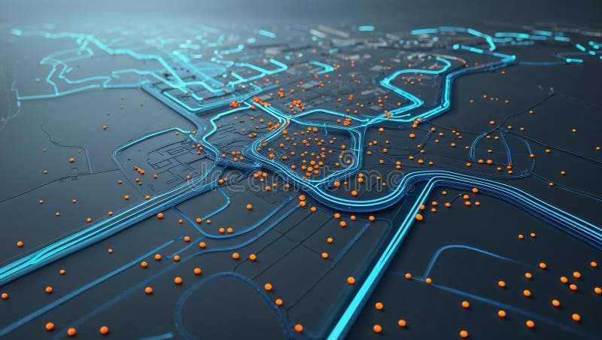
TECHNICAL ARCHITECTURE
The Agent Ecosystem
Traffic Intelligence Agent
Safety & Helmet Agent
Agent Coordination
Monitors congestion patterns, analyzes traffic flow, and optimizes signal timing recommendations.
Computer vision detection of helmet violations, unsafe driving practices, and accident scenes.
1
Event Detection
Any agent detects an incident and publishes to the message bus.
2
Cross-Agent Analysis
Real-time congestion detection
Helmet compliance detection
Relevant agents receive event data and provide specialized analysis.
Flow optimization algorithms
Violation classification
3
Unified Response
Cleanliness Agent
Emergency Response Agent
Coordinated action across all relevant city departments.
Identifies littering incidents, garbage accumulation, and environmental hazards through image analysis.
Coordinates accident reporting, dispatches alerts via SMTP, and integrates nearest hospital mapping.
Key Capabilities
Garbage detection
Instant alert dispatch
Sub-second processing
Real-time sync
Littering pattern analysis
Hospital GPS integration
Horizontal scaling
Fault tolerance

Slide 7
UNIQUE FEATURE
The Officer Feed: Real-Time Command Dashboard
Dashboard Overview
Civic Credit System
The Officer Feed is a centralized command interface where police officers review citizen-submitted reports, analyze AI-extracted vehicle data, and award civic credits—building trust between law enforcement and communities.
How It Works
1.
Citizen submits report with image
2.
AI extracts vehicle metadata
3.
Officer reviews and validates
Image Review
Vehicle Data
Credit Awards
4.
Officer awards credits manually
Citizen reports
AI extraction
Community trust
5.
Citizen receives notification
Credit Tiers
AI Image Analysis
Vehicle Forensics
Traffic Violation
50 credits
Automatic processing of submitted images
Plate Number: OCR extraction with 95%+ accuracy
Safety Hazard
75 credits
Accident Report
100 credits
Object detection for vehicles and violations
Brand Recognition: 50+ vehicle makes identified
Cleanliness Issue
25 credits
Geolocation tagging with GPS coordinates
Color Detection: Automated color classification
Community Impact
The credit system transforms citizens from passive observers to active participants in urban safety, building trust and collaboration between communities and law enforcement.

Slide 8

SOCIAL IMPACT
The Emergency Loop: Faster Response, Saved Lives
Accident Reporting Workflow
The Impact of Speed
Traditional Response
7+ min
1. Capture
2. AI Process
3. Alert
Citizen snaps photo
Severity assessment
SMTP dispatch
<30 sec
UrbanPulse AI Response
Live Image Transmission
Nearest Hospital Mapping
SMTP email alerts include live images from the accident scene, giving hospitals and police immediate visual context.
AI suggests nearest medical facilities based on user's GPS input, with directions and estimated travel time.
Research shows:
Response ≥12 min = 46% higher mortality
Traffic causes 10,387+ EMS delays annually
Golden hour: First 60 minutes critical
Attachments:
Real-time GPS tracking
SMTP Alert System
Scene Photo
GPS Location
Timestamp
Optimal route calculation
ETA to hospital
Instant email dispatch
Multiple recipients
Critical Time Savings
Rich media attachments
Every minute counts. Our system reduces notification-to-dispatch time from minutes to seconds.
Delivery confirmation

Slide 9
TECHNOLOGY & MARKET
Technology Stack & Market Opportunity
Technology Stack
Market Opportunity
Gemini 1.5 Flash API
AI in Smart Cities Market
$460B+
Google AI
By 2034 at 27.8% CAGR
Multimodal AI processing for images, text, and data analysis with sub-second response times.
Computer Vision
#1
Fastest
OpenCV + Custom Models
Traffic Management is top AI application
Computer Vision growth segment
Real-time image processing for vehicle detection, plate recognition, and safety monitoring.
Key Growth Drivers
Rapid urbanization & infrastructure strain
React.js Frontend
Sustainability & efficiency mandates
Modern Web Framework
Public safety & emergency response needs
Responsive, component-based UI with real-time updates and mobile-first design.
AI/IoT/5G technology convergence
SMTP Email Integration
Alert System
Instant email alerts with image attachments for emergency response coordination.
Total Addressable Market
$1.4T
Smart Cities + Insurance Integration
By 2030

Slide 10
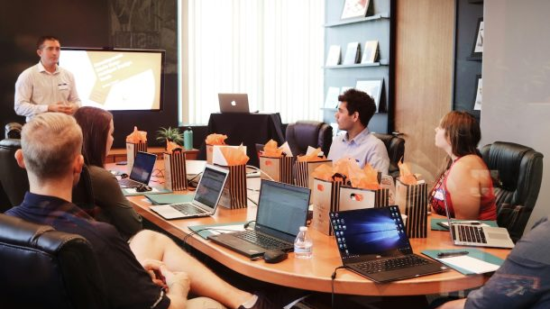
BUSINESS MODEL & TEAM
Scalable SaaS for Smart Cities
Revenue Model
Team Codexelerate
Municipal Subscriptions
Primary
R
Rithvik
Tiered pricing based on city population and deployment scope.
Team Lead & AI Architect
Small City
Medium City
Metro City
H
Hitesh
$5K/mo
$15K/mo
$50K/mo
Backend & Computer Vision
Insurance Partnerships
Growth
S
Sachin
Risk assessment data, accident verification, and fraud detection services for insurance companies.
Frontend & UX Design
Premium Analytics
Add-on
H
Hamshith
Advanced reporting, predictive analytics, custom dashboards, and API access for enterprise clients.
DevOps & Integration
Target Customers
Our Vision
Municipal Governments
Smart City Initiatives
"Transforming cities from reactive to predictive, from fragmented to unified, from chaotic to intelligent. UrbanPulse AI is the nervous system for the smart cities of tomorrow."
Police Departments
Insurance Companies
Why UrbanPulse AI Wins
2025
Multi-agent architecture • Real-time processing • Civic engagement • Proven stack
Hackathon Ready

